Slide 1
INDUSTRIAL MANAGEMENT Chapter 12
CSE 417 Section 15/AB Term II
Session 2017-18
Department of Computer Science and Engineering
Instructor: Arif S. Bhuiyan, MSEd

Slide 2

Project Time Management
Information Technology Project Management, Seventh Edition
Thanks to Maj Dr Muhammad Nazrul Islam

Slide 3
Importance of Project Schedules
Managers often cite delivering projects on time as one of their biggest challenges
Time has the least amount of flexibility; it passes no matter what happens on a project
Schedule issues are the main reason for conflicts on projects, especially during the second half of projects

Slide 4
Project Time Management Processes
Planning schedule management: determining the policies, procedures, and documentation that will be used for planning, executing, and controlling the project schedule
Defining activities: identifying the specific activities that the project team members and stakeholders must perform to produce the project deliverables
Sequencing activities: identifying and documenting the relationships between project activities
Estimating activity resources: estimating how many resources a project team should use to perform project activities
Estimating activity durations: estimating the number of work periods that are needed to complete individual activities
Developing the schedule: analyzing activity sequences, activity resource estimates, and activity duration estimates to create the project schedule
Controlling the schedule: controlling and managing changes to the project schedule

Slide 5
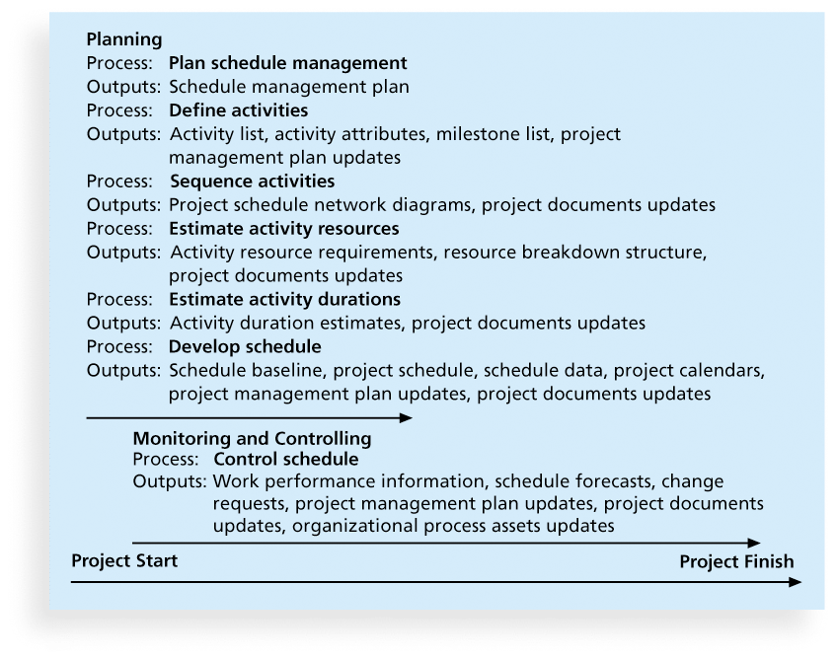
Figure 6-1. Project Time Management Summary

Slide 6
Planning Schedule Management
The project team uses expert judgment, analytical techniques, and meetings to develop the schedule management plan

Slide 7
Network Diagrams
Network diagrams are the preferred technique for showing activity sequencing
A network diagram is a schematic display of the logical relationships among, or sequencing of, project activities
Two main formats are the arrow and precedence diagramming methods

Slide 8
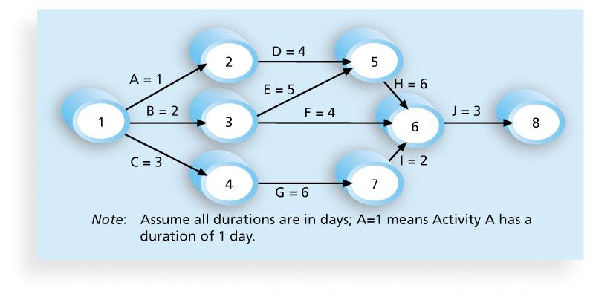
Figure 6-2. Network Diagram for Project X

Slide 9
Arrow Diagramming Method (ADM)
Also called activity-on-arrow (AOA) network diagrams
Activities are represented by arrows
Nodes or circles are the starting and ending points of activities
Can only show finish-to-start dependencies

Slide 10
Process for Creating AOA Diagrams
1. Find all of the activities that start at node 1. Draw their finish nodes and draw arrows between node 1 and those finish nodes. Put the activity letter or name and duration estimate on the associated arrow
2. Continuing drawing the network diagram, working from left to right. Look for bursts and merges. Bursts occur when a single node is followed by two or more activities. A merge occurs when two or more nodes precede a single node
3. Continue drawing the project network diagram until all activities are included on the diagram that have dependencies
4. As a rule of thumb, all arrowheads should face toward the right, and no arrows should cross on an AOA network diagram

Slide 11
Precedence Diagramming Method (PDM)
Activities are represented by boxes
Arrows show relationships between activities
More popular than ADM (Arrow Diagramming Method) method and used by project management software
Better at showing different types of dependencies

Slide 12
Critical Path Method (CPM)
CPM is a network diagramming technique used to predict total project duration
A critical path for a project is the series of activities that determines the earliest time by which the project can be completed
The critical path is the longest path through the network diagram and has the least amount of slack or float
Slack or float is the amount of time an activity may be delayed without delaying a succeeding activity or the project finish date

Slide 13
Calculating the Critical Path
First develop a good network diagram
Add the duration estimates for all activities on each path through the network diagram
The longest path is the critical path
If one or more of the activities on the critical path takes longer than planned, the whole project schedule will slip unless the project manager takes corrective action

Slide 14
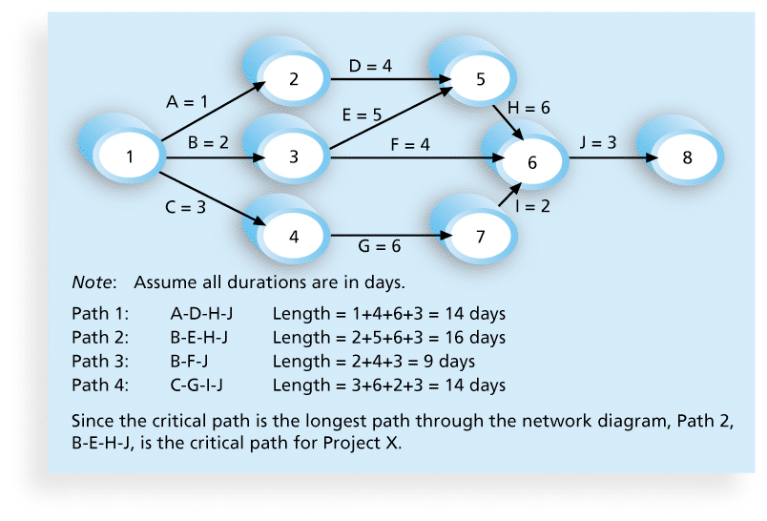
Figure 6-8. Determining the Critical Path for Project X

Slide 15
More on the Critical Path
The critical path is not the one with all the critical activities; it only accounts for time
Remember the example of growing grass being on the critical path for Disney’s Animal Kingdom
There can be more than one critical path if the lengths of two or more paths are the same
The critical path can change as the project progresses

